Slide 1
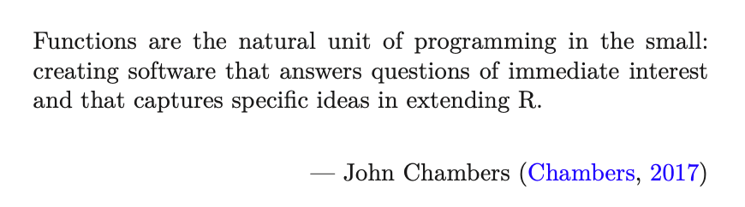
Data Science for Operational Researchers using R
03 – Functions, Lists and Functionals
https://github.com/JimDuggan/Data-Science-for-OR

Slide 2
Course Overview
Topic | Description
 | Morning 1
1 | Introduction to R and Posit Cloud
2 | Atomic Vectors
3 | Functions, Lists and Functionals
4 | Data Frames and Tibble
5 | ggplot2
 | Morning 2
6 | Data transformation with dplyr
7 | Relational Data with dplyr
8 | OR Example 1 – Exploratory Data Analysis
9 | OR Example 2 – System Dynamics

Slide 3
(1) Functions
A function can be defined a group of instructions that: takes input, uses the input to compute other value, and returns a result
Functions are building blocks in R
We already have used many R inbuilt functions: sample(), table()
Now we can write our own in a source file.

Slide 4
General Form
function(arguments)
expression
arguments gives the arguments, separated by commas.
Expression (body of the function) is any legal R expression, usually enclosed in { }
Last evaluated expression is returned
return() can also be used, but usually for exceptions.
f()

Slide 5
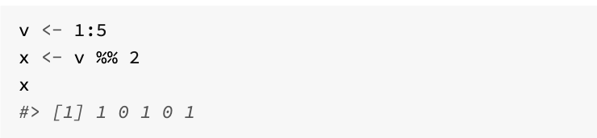
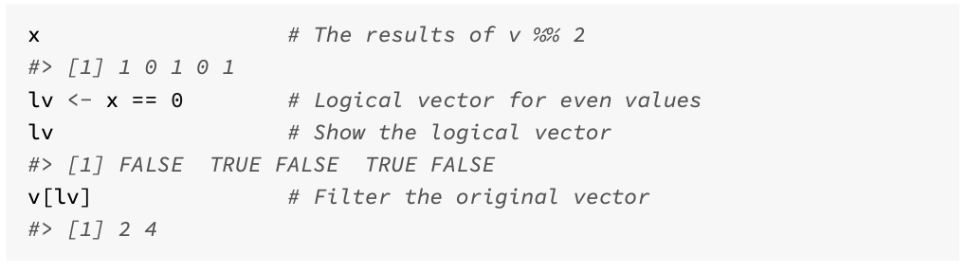
A first function – returning even numbers
Our first function will take in a vector of numbers, and return only those that are even.
To do this, R’s modulus operator %% is used, as this returns the remainder of two numbers, following their division
We will focus on the data processing first, and then encapsulate this within a function

Slide 6
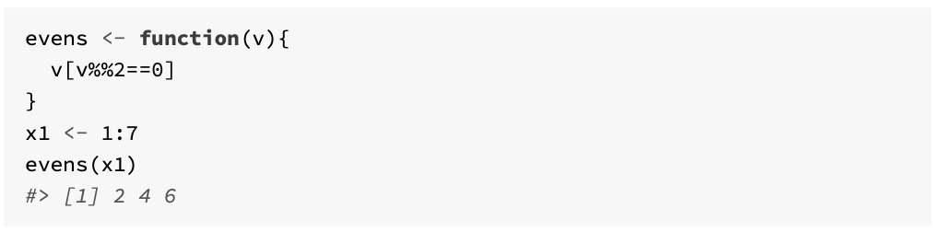
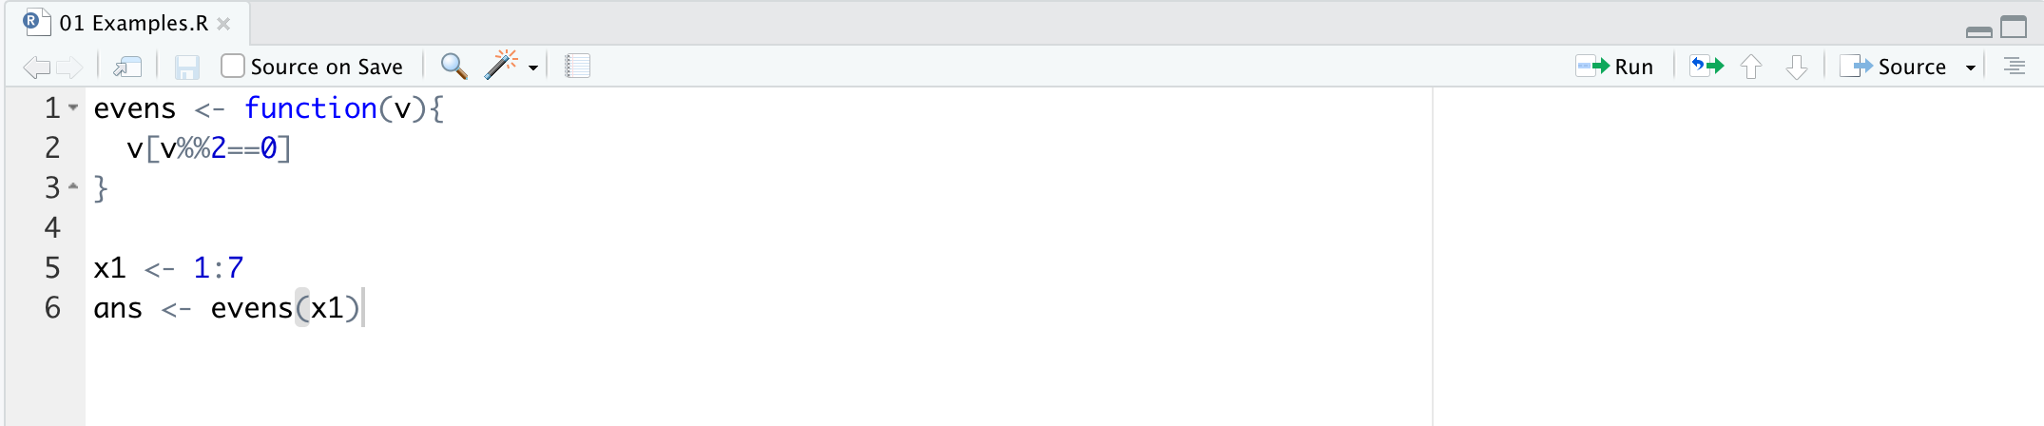
The function, and a source file

Slide 7
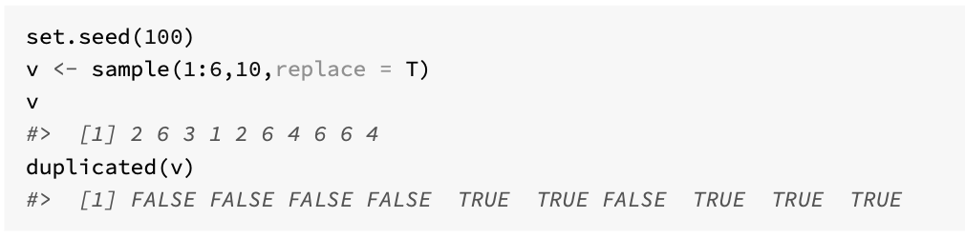
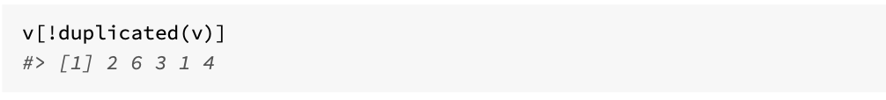
A second function – removing duplicates
This builds on the work of others
duplicated() function
Will use this to identify duplicates so they can be removed within a new function

Slide 8
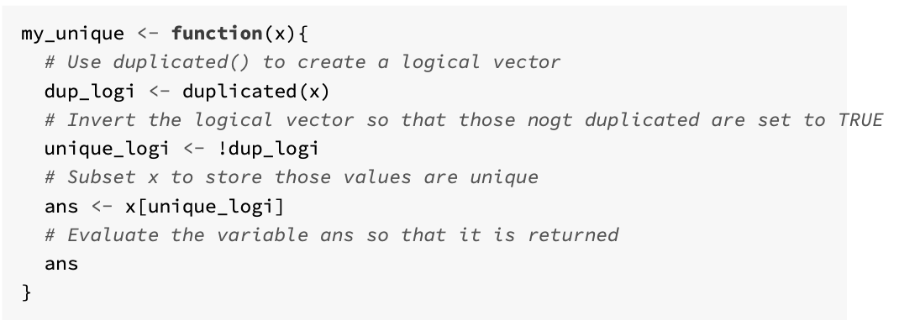
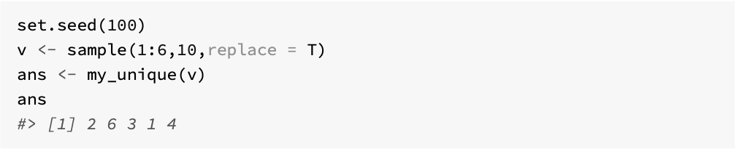
Function Code

Slide 9
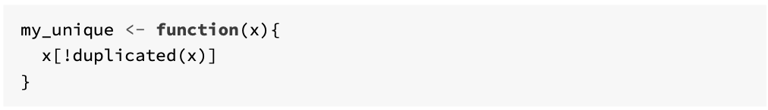
A reduced size version…

Slide 10
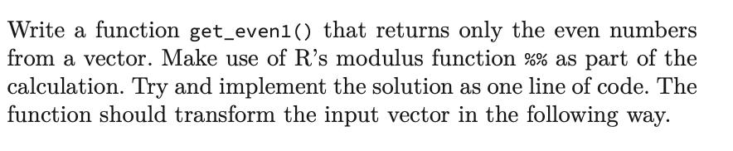
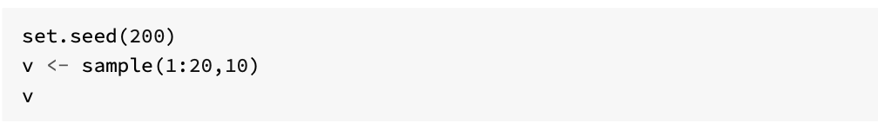
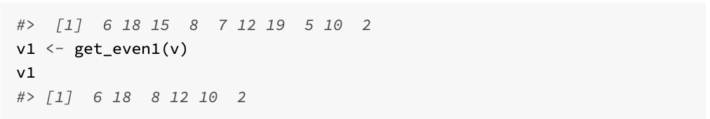
Challenge 3.1

Slide 11
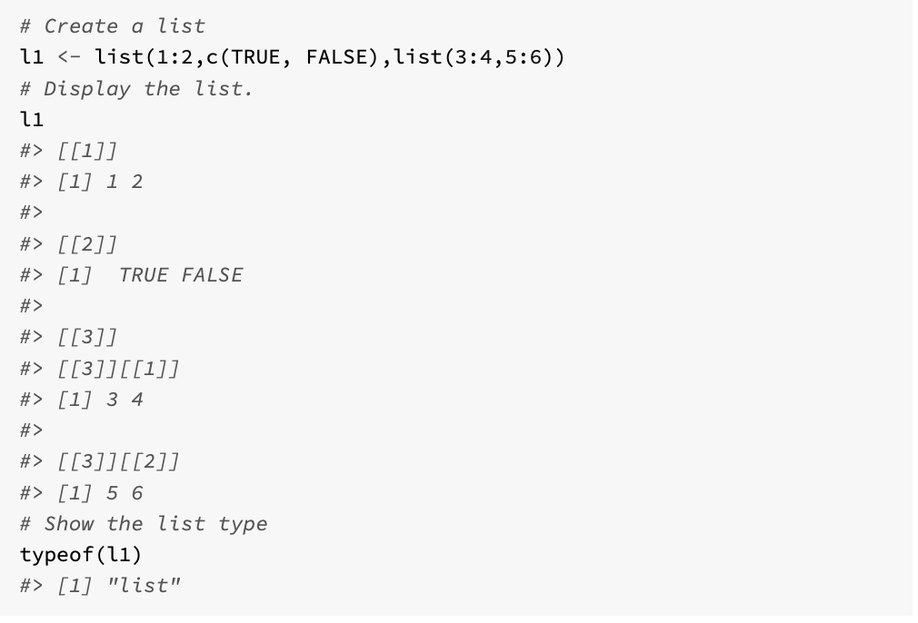
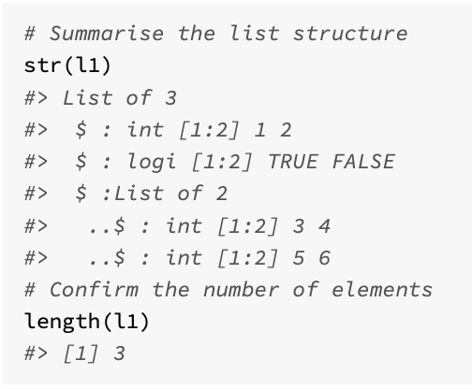
Lists in R
A list is a vector that can contain different types, including a list.
A list can be defined using the list() function
This is similar to the c() function used to create atomic vectors.

Slide 12
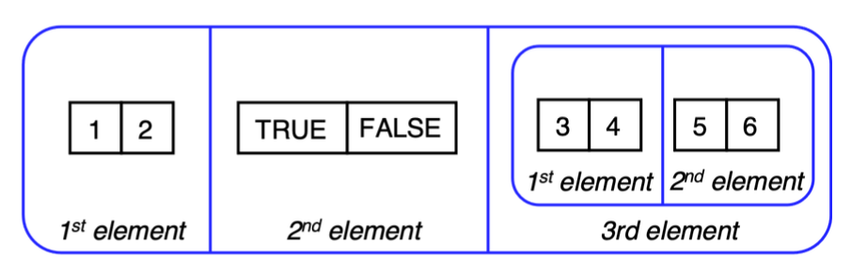
Visualising a list

Slide 13
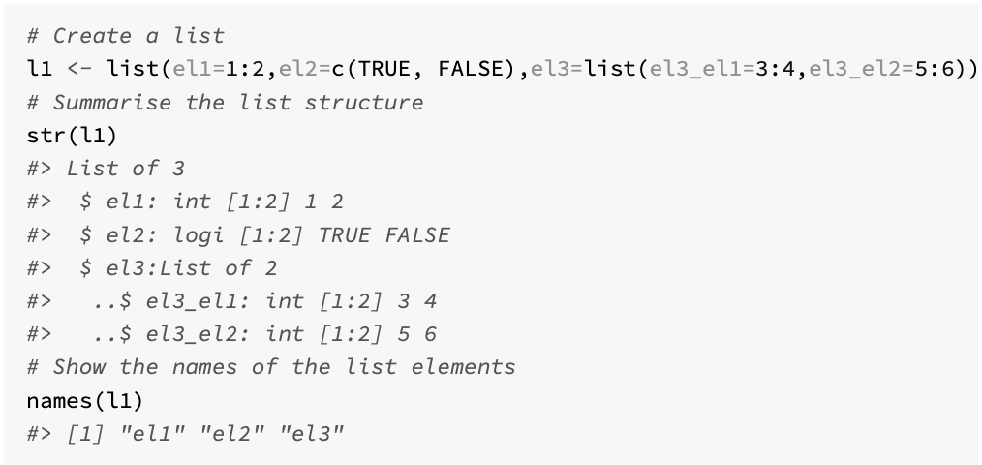
Naming list elements

Slide 14
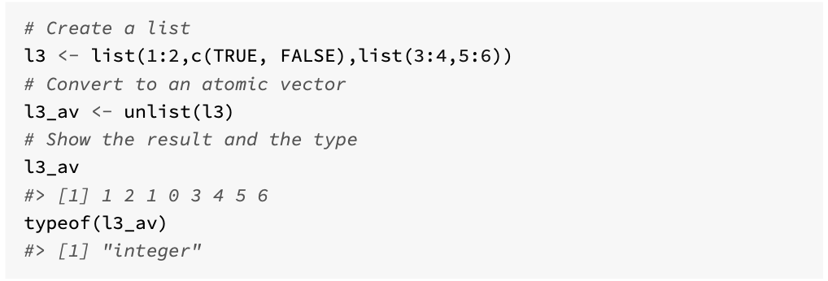
Conversion to an atomic vector

Slide 15
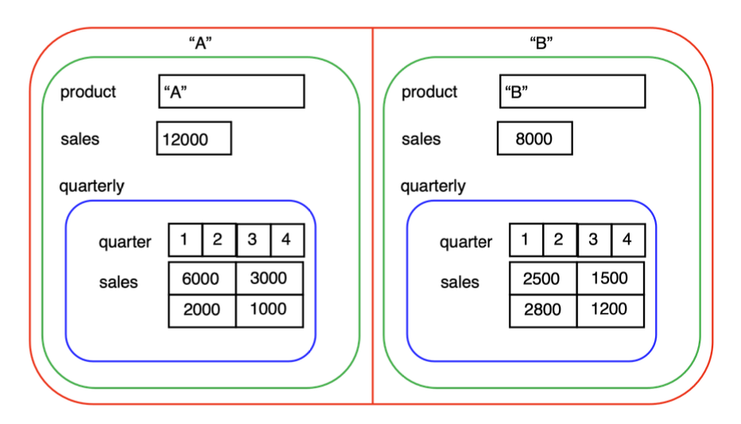
Subsetting lists
The single square bracket [ will always return a list, an dis similar to what we used for atomic vectors
The double square bracket [[ will return the contents of the list at a specified location
The tag $ operator is a convenient way to extract the contents of a list (similar to [[)

Slide 16
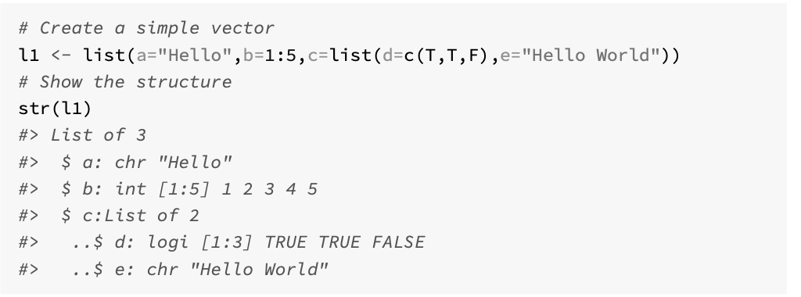
Exploring subsetting – a simple example

Slide 17
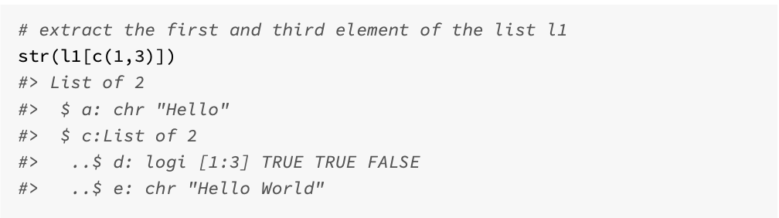

Slide 18
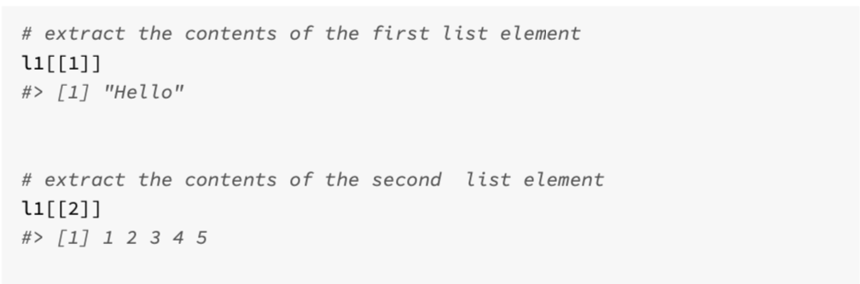

Slide 19
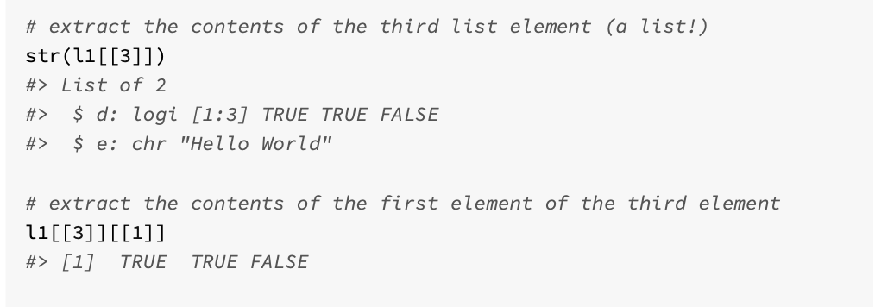

Slide 20
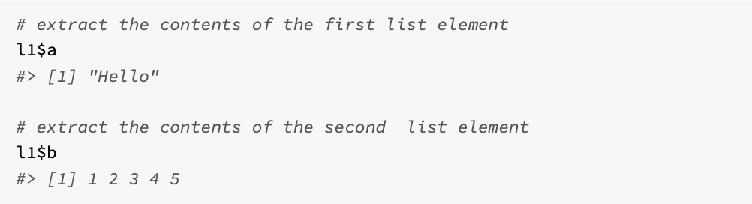

Slide 21
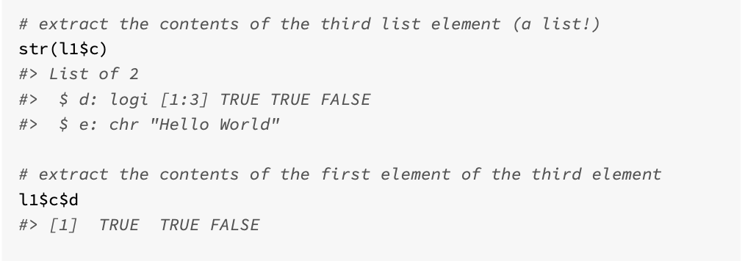

Slide 22
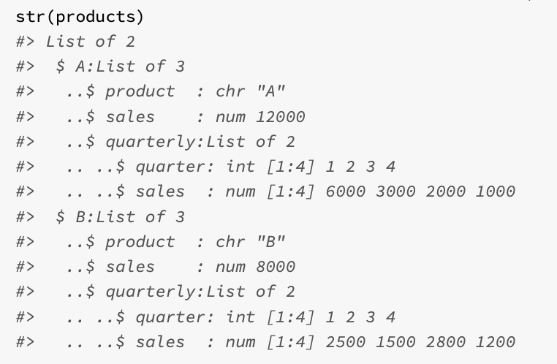
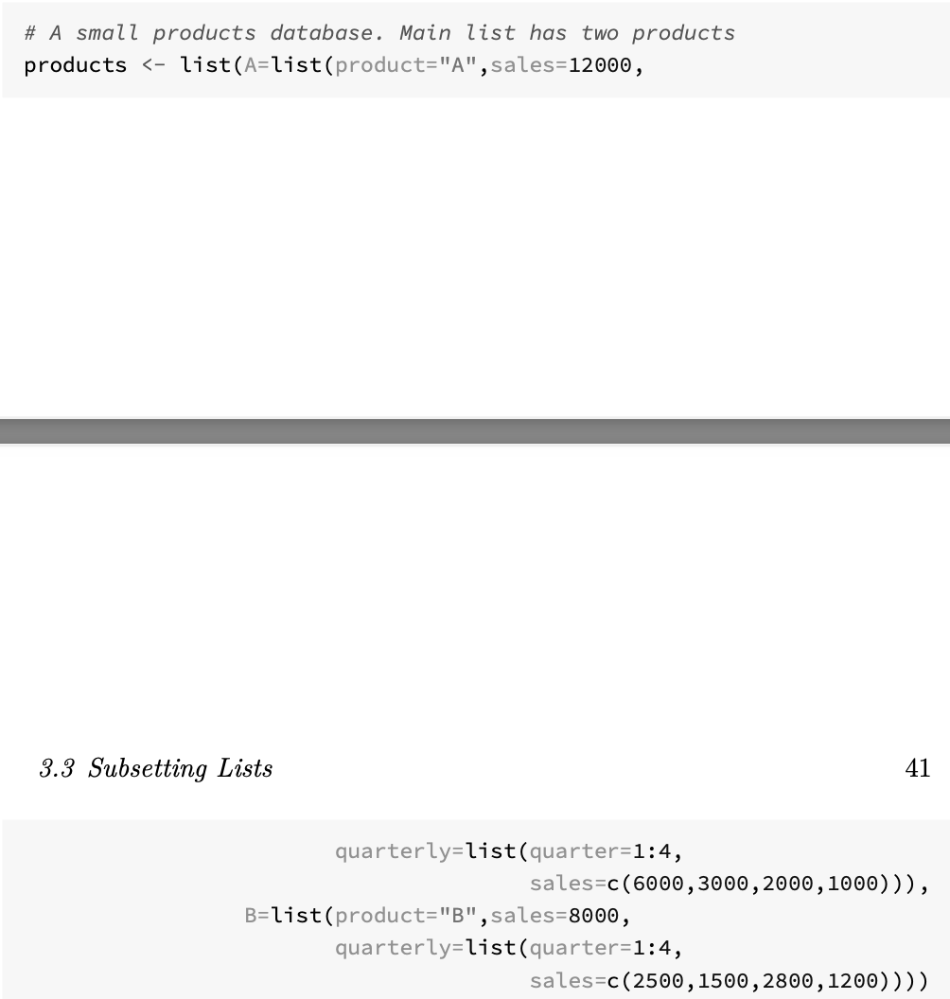
Exploring another list…

Slide 23
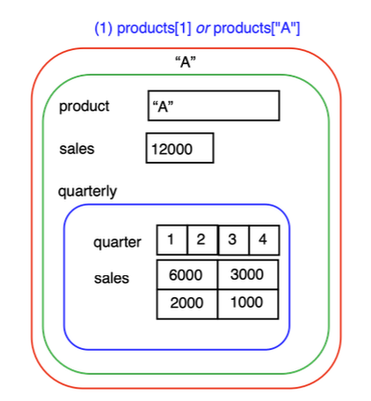
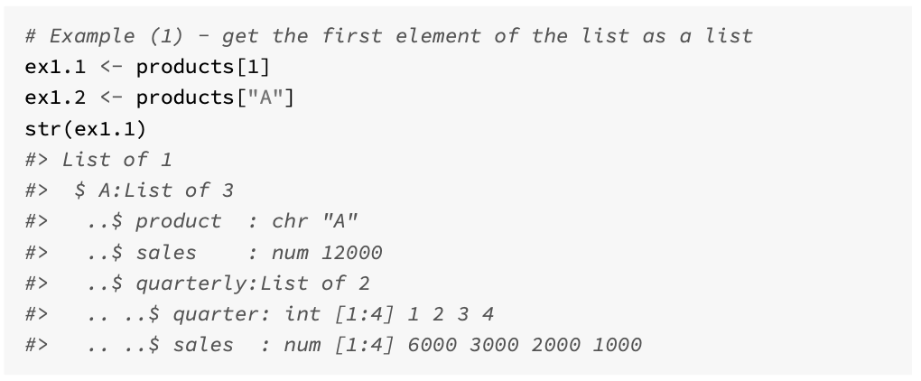

Slide 24
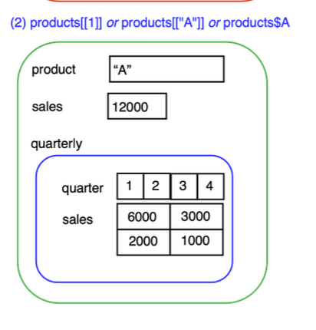
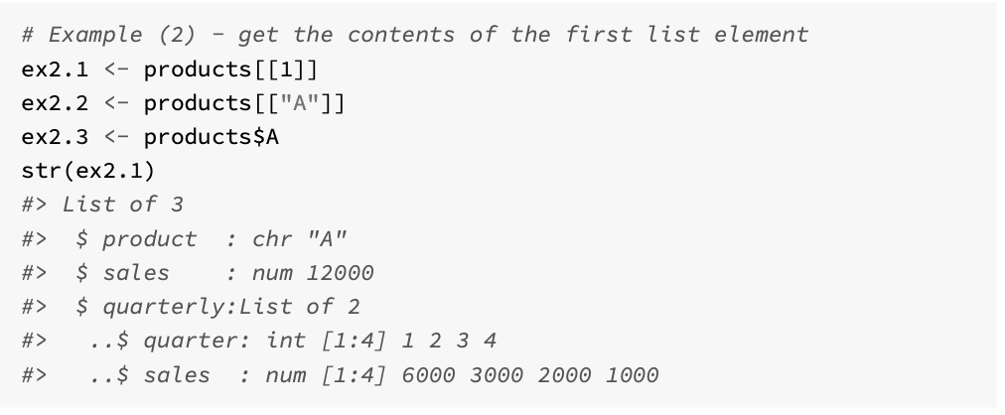

Slide 25
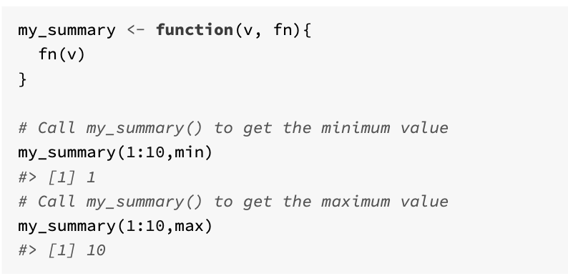
Functionals
A function can accept another function as an argument
These functions are known as functionals and are a key part of R

Slide 26
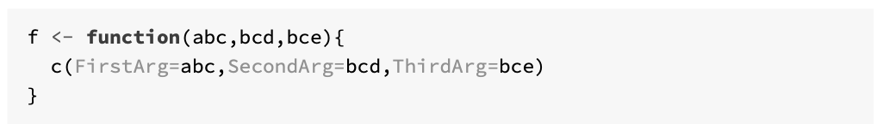
Arguments
It is useful to distinguish between the formal arguments, which are the property of the function itself, and the actual arguments, which can vary when the function is called (Wickham, 2019).
Each function in R is defined with a set of formal arguments that have a fixed positional order, and often that is the way arguments are then passed into functions
However, arguments can also be passed in by complete name or partial name, and arguments can also have default values

Slide 27
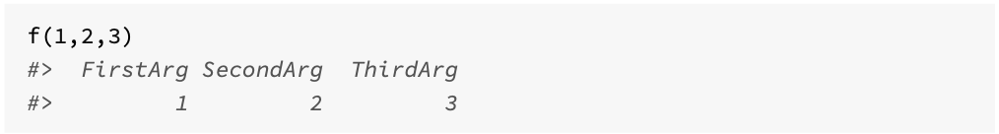
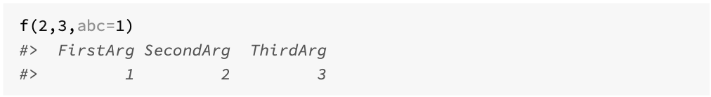
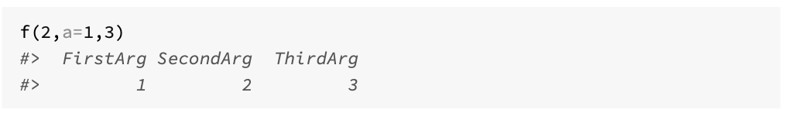
Flexibility in calls

Slide 28
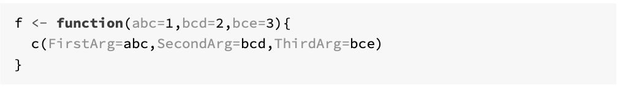
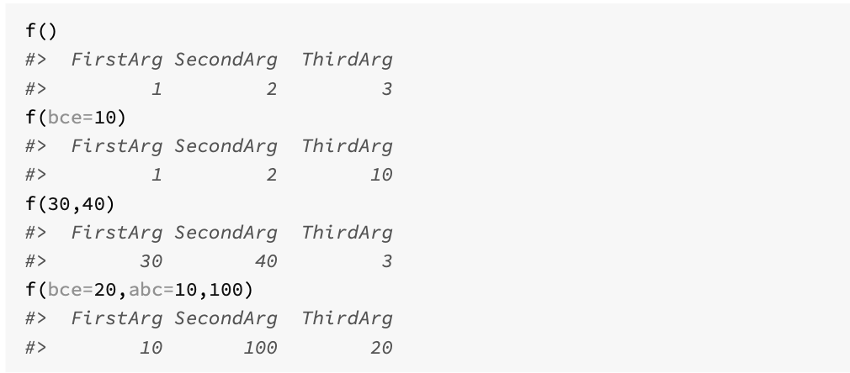
Setting default values

Slide 29
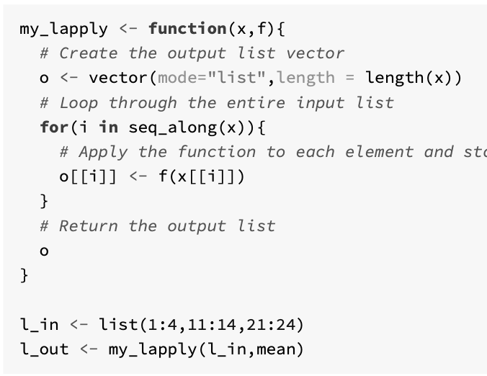
The apply family of functionals
An important aspect of programming with R, which is the use of functionals
They take data and functions as part of their input, and use that function to process data.
In many cases, these functions can be used instead of loops to iterate over data and return a result

Slide 30
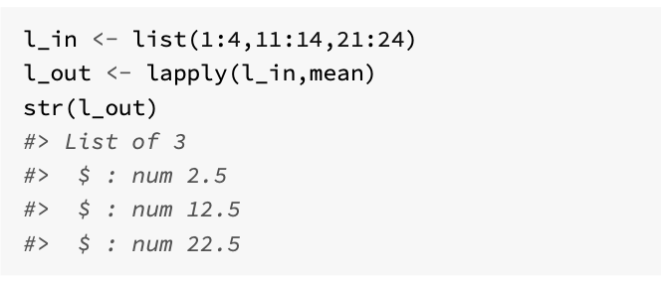
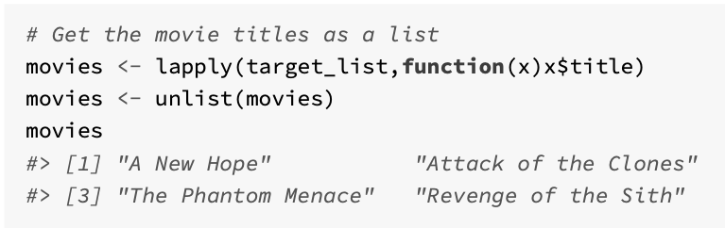
lapply(x,f)
Accepts as input a list x and a function f
Returns as output a new list of the same length as x, where each element in the new list is the result of applying the function f to the corresponding element of the input list x.
The function can be embedded (anonymous) – example from repurrrsive.

Slide 31
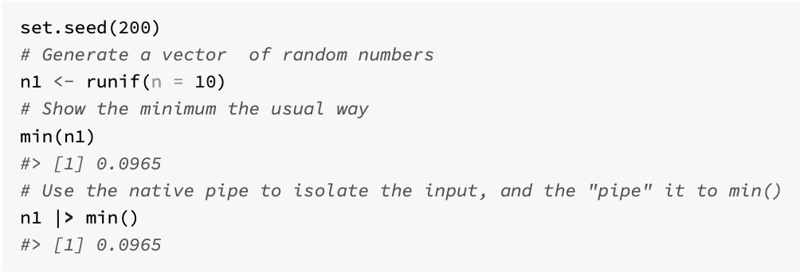
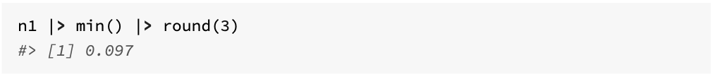
Native Pipe Operator |>
Allows you to chain a number of operations together, without having to assign intermediate variables
Can construct a data pipeline
The general format of the pipe operator is LHS |> RHS, where LHS is the first argument of the function defined on the RHS.

Slide 32
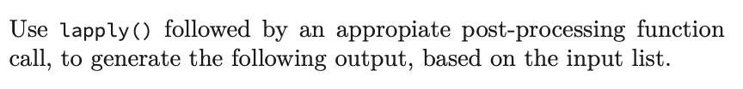
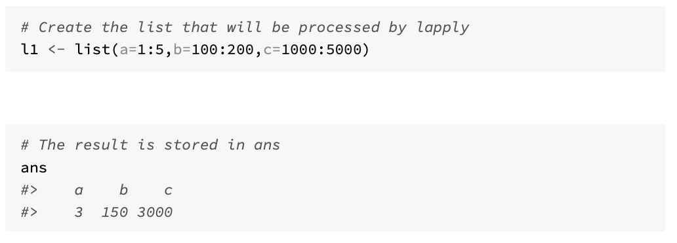
Challenge 3.2

